Slide 1

Presentation Materials Created by Mimetics Inc.
Free use by anyone for non-commercial purposes
Copyrights, Trademarks and other Registered Marks the Property of their Owners

Slide 2
Grade 8 Systems
Class 10 – Challenge for Myke
Notes:
We want to introduce the Jade Robot and it’s Tools in more detail along with our action plans for it.
It’s interesting, but it’s easy to criticize something when it’s done (especially when you have experience) – a *LOT* more difficult getting it right from the start. Also, preparing this presentation was a great way to review and think about what we should be doing.

Slide 3
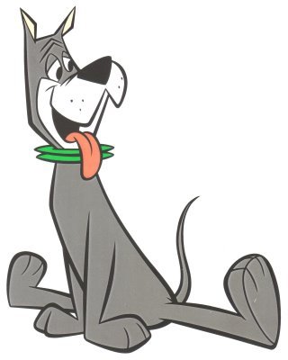
Recap
What are the Steps for Creating a Program?
What is the Robot Program Structure?
What do you do when things go wrong?
How do you Document a Program?
Notes:
Can Demo Jade Scratch if people are interested. In doing this product I’ve had a few interesting discoveries – one was going with a simpler programming language actually has a *LOT* of value for an expert like myself.

Slide 4
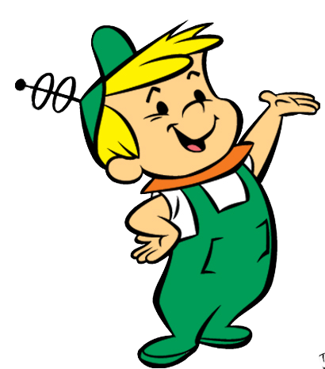
Creating a Program
Get Requirements
Break Requirements into Parts
For Each Part, List Statement Types
Create a Sequence of Statements
Test Statements for Each Part
Work in Sequence and Build Up Program as Sum of Parts
Test Final Program to Requirements
Celebrate!!!
Notes:
Can Demo Jade Scratch if people are interested. In doing this product I’ve had a few interesting discoveries – one was going with a simpler programming language actually has a *LOT* of value for an expert like myself.

Slide 5
Recap
What are the Steps for Creating a Program?
What is the Robot Program Structure?
What do you do when things go wrong?
How do you Document a Program?
Notes:
Can Demo Jade Scratch if people are interested. In doing this product I’ve had a few interesting discoveries – one was going with a simpler programming language actually has a *LOT* of value for an expert like myself.

Slide 6
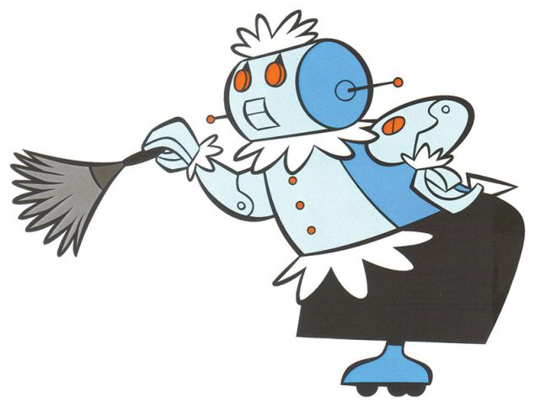
Robot Program Structure
Initialize Robot
Get Input
Process
Repeat (Loop)
Output Processed Inputs
Shutdown Robot
(Stop)
Notes:
Can Demo Jade Scratch if people are interested. In doing this product I’ve had a few interesting discoveries – one was going with a simpler programming language actually has a *LOT* of value for an expert like myself.

Slide 7
What to do when things go wrong
Notes:
Can Demo Jade Scratch if people are interested. In doing this product I’ve had a few interesting discoveries – one was going with a simpler programming language actually has a *LOT* of value for an expert like myself.

Slide 8

Steps to Solve a Problem
Check Spelling/Statements
Single Step through the Program
Add Display Updates and LED Outputs to Track Progress
Isolate small Parts of the Program and Test Operation
Notes:
Can Demo Jade Scratch if people are interested. In doing this product I’ve had a few interesting discoveries – one was going with a simpler programming language actually has a *LOT* of value for an expert like myself.

Slide 9
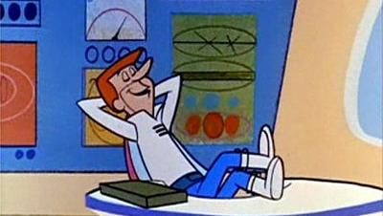
Documenting Programs
Notes:
We want to introduce the Jade Robot and it’s Tools in more detail along with our action plans for it.
It’s interesting, but it’s easy to criticize something when it’s done (especially when you have experience) – a *LOT* more difficult getting it right from the start. Also, preparing this presentation was a great way to review and think about what we should be doing.

Slide 10
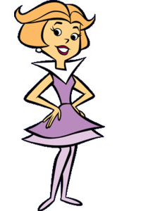
Good Documentation has:
PICTURES!!!
Program Requirements
Overall Program Description
Breakout of Program Parts
List (with Description) of:
Inputs & Outputs
Variables
Subroutines & Functions (if used)
Notes:
Can Demo Jade Scratch if people are interested. In doing this product I’ve had a few interesting discoveries – one was going with a simpler programming language actually has a *LOT* of value for an expert like myself.

Slide 11
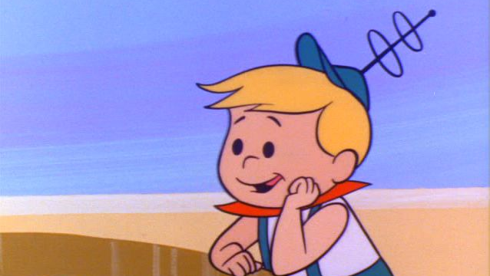
Challenge for Myke

Slide 12
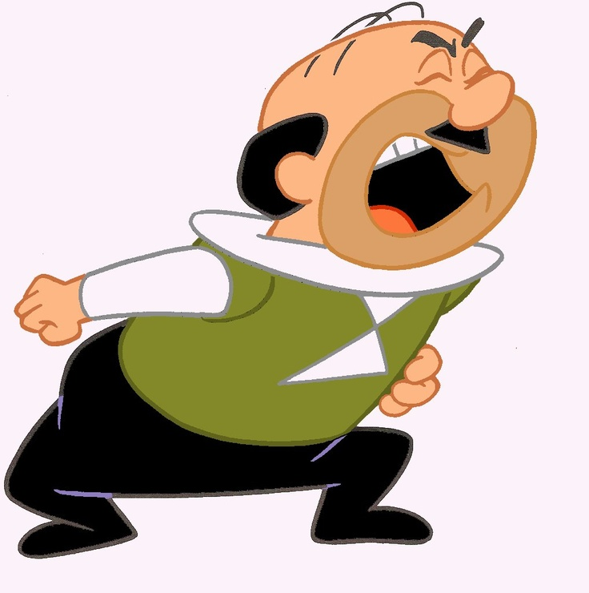
What is Goal?
Two (Input) Sensors:
Outputs:
Reach Goal:
Status Information:

Slide 13
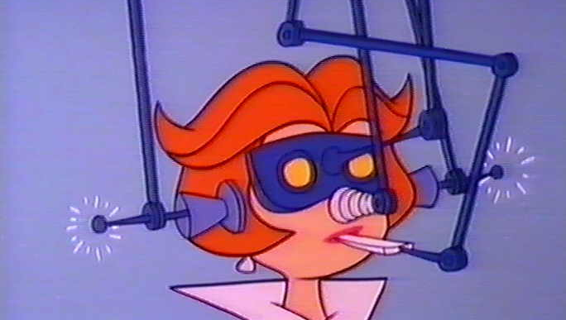
Thank
You!
Challenge for Myke

